Slide 1
Emergency Department
Process Review

Slide 2
Simulation result
(with increase in patient numbers)

Slide 3
Simulation Result (baseline & increased arrivals)
Baseline (11 arrivals/hour)
New Baseline (12 arrivals/hour)
replication | avg_wait_min | p90_wait_min | avg_los_min | p90_los_min
1 | 43.2 | 129.7 | 156.9 | 371.9
2 | 40.1 | 96.3 | 154.1 | 349.0
3 | 27.2 | 71.6 | 132.2 | 302.3
4 | 24.1 | 59.8 | 124.1 | 269.1
5 | 21.9 | 58.9 | 123.0 | 260.3
6 | 23.7 | 56.5 | 127.6 | 271.5
7 | 30.5 | 75.2 | 132.4 | 274.0
8 | 45.6 | 118.2 | 159.2 | 406.4
9 | 29.7 | 72.6 | 134.6 | 289.8
10 | 39.8 | 98.3 | 147.8 | 362.7
11 | 36.9 | 94.2 | 146.7 | 346.2
12 | 33.7 | 83.0 | 140.9 | 316.4
Summary | 33.0 | 84.5 | 140.0 | 318.3
replication | avg_wait_min | p90_wait_min | avg_los_min | p90_los_min
1 | 156.2 | 321.4 | 334.4 | 917.8
2 | 155.2 | 333.6 | 327.2 | 927.5
3 | 88.7 | 201.8 | 221.7 | 574.9
4 | 293.0 | 763.0 | 513.9 | 1222.3
5 | 85.9 | 187.3 | 219.3 | 551.8
6 | 292.9 | 752.7 | 531.3 | 1541.0
7 | 112.0 | 205.2 | 264.9 | 631.4
8 | 82.7 | 179.4 | 219.2 | 545.0
9 | 160.4 | 351.3 | 342.8 | 933.4
10 | 73.0 | 162.5 | 196.5 | 461.0
11 | 163.3 | 336.1 | 352.8 | 936.8
12 | 62.4 | 149.9 | 184.0 | 419.4
Summary | 143.8 | 328.7 | 309.0 | 805.2
Increased arrivals
Legend:
avg_wait_min: average wait time in minutes
P90_wait_min: wait time in the 90th percentile
avg_los_min: average length-of-service (los) in minutes
P90_los_min: lost in the 90th percentile
Notes:
Simulation models Fast Track + Main ED with stochastic arrivals to quantify baseline performance and test capacity fixes.

Slide 4
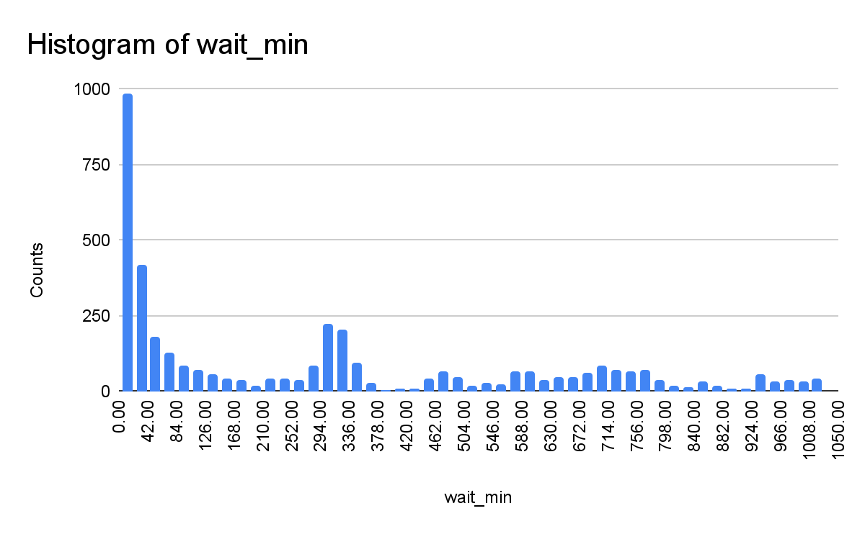
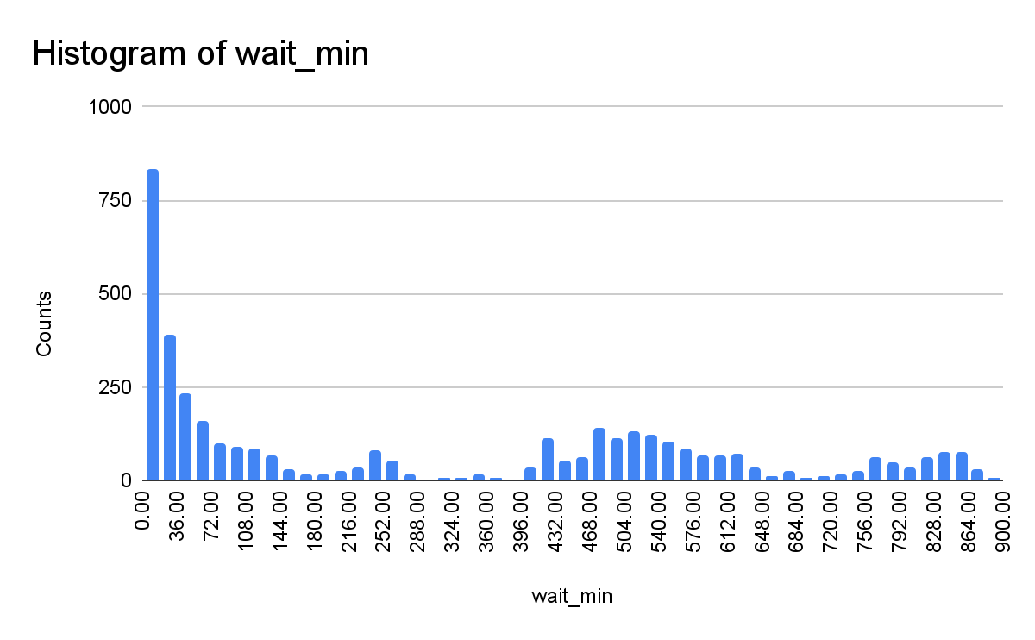
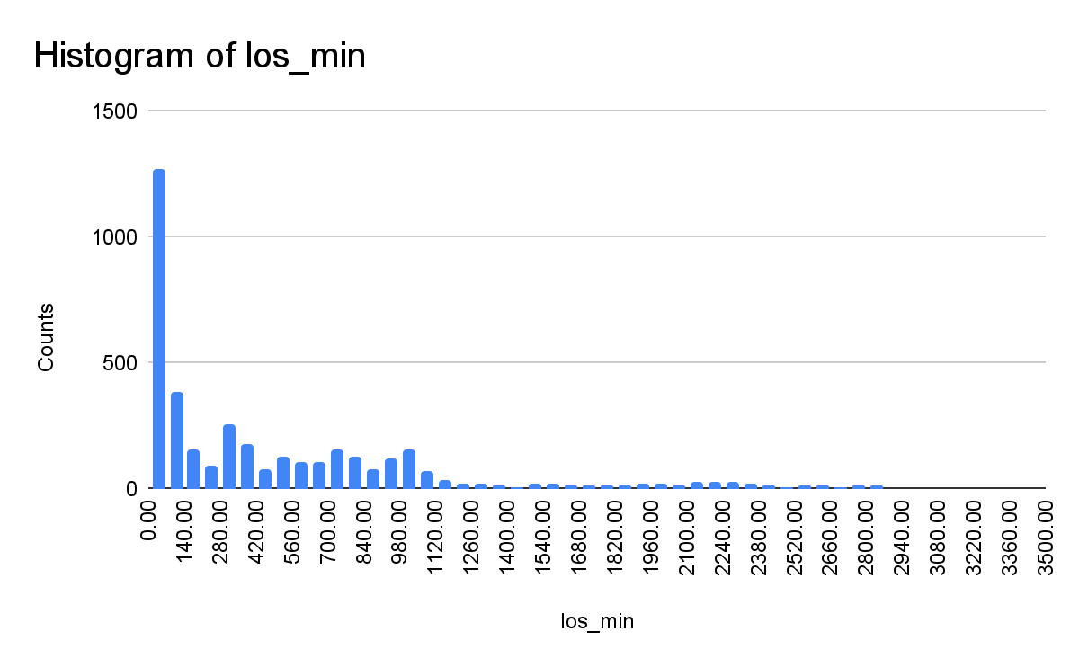
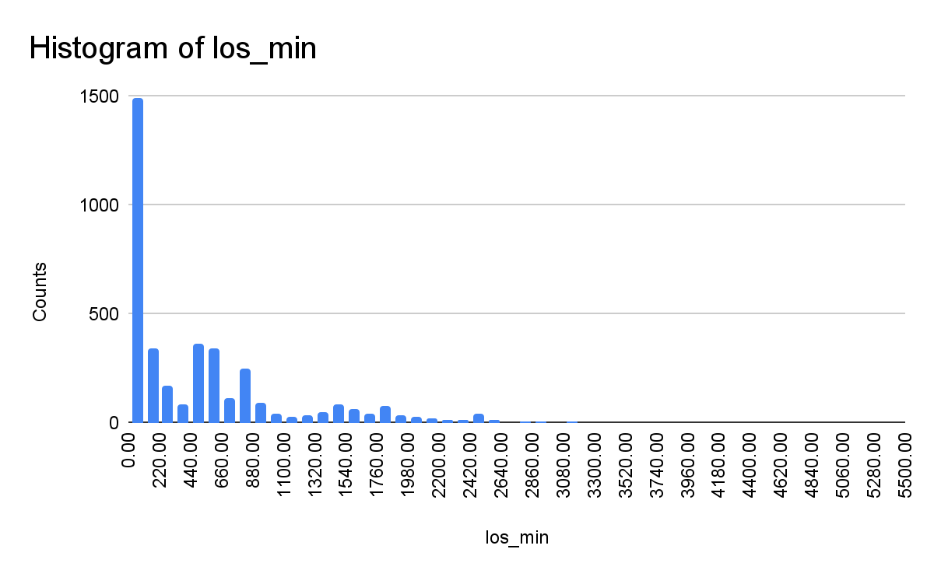
Simulation Replications Metrics for New Baseline
Replication #4:
Replication #6:
Replications 4 & 6 (longest wait time and los) shows a cascading effect of wait times and los piling upon each other
Mean: 293 mins
90th percentile: 763 mins
Mean: 293 mins
90th percentile: 752 mins
Mean: 514 mins
90th percentile: 1222 mins
Mean: 531 mins
90th percentile: 1541 mins

Slide 5
Simulation Replication Endtime Data (New Baseline)
replication | time_min | bed_queue_len | main_doc_queue_len | main_nurse_queue_len | fast_queue_len | beds_in_use
1 | 20130 | 0 | 47 | 52 | 1 | 14
2 | 20130 | 7 | 54 | 60 | 0 | 20
3 | 20130 | 0 | 51 | 57 | 6 | 11
4 | 20130 | 0 | 154 | 187 | 0 | 7
5 | 20130 | 0 | 33 | 39 | 25 | 12
6 | 20130 | 0 | 148 | 170 | 24 | 17
7 | 20130 | 0 | 29 | 30 | 4 | 20
8 | 20130 | 0 | 16 | 17 | 6 | 12
9 | 20130 | 0 | 41 | 44 | 8 | 15
10 | 20130 | 0 | 22 | 22 | 2 | 13
11 | 20130 | 0 | 64 | 71 | 0 | 17
12 | 20130 | 0 | 21 | 18 | 2 | 14
At the end of each replications, main doc and main nurse queue is always the longest, especially replications 4 & 6 with the longest wait time and los.
This suggests that increasing the number of main doctor or nurse may have the best effect to address the surge in patient numbers.

Slide 6
Scenario Comparison and Recommendation

Slide 7
Simulation Result (Multiple Scenarios)
Scenario | avg_wait_min | avg_los_min | num_discharged | num_admitted | avg_boarding_min
Baseline | 33.0 | 140.0 | 3204.3 | 467.3 | 457.7
New Baseline (+1 arrival/hour) | 143.8 | 309.0 | 3437.4 | 504.3 | 478.0
+1 fast doctor and 2 nurses | 134.8 | 301.2 | 3436.4 | 515.8 | 468.5
+1 main doctor and 2 nurses | 20.7 | 123.7 | 3487.6 | 529.9 | 474.2
+5 ED beds | 117.2 | 268.1 | 3442.8 | 505.3 | 470.9
Parameters to reduce wait times and los:
Reduce probability of tests and admission
Reduce delay time (service time to patients, lab time, transfer time)
Increase doctor, nurses and beds
However, changes to parameter 1 & 2 is usually out of our control. Hence, only changes to parameter 3 is modeled for this study. However, if there are changes to parameter 1 and 2, they can be configured for further testing purposes.

Slide 8
Simulation Replication Endtime Data
replication | time_min | bed_queue_len | main_doc_queue_len | main_nurse_queue_len | fast_queue_len | beds_in_use
1 | 20130 | 0 | 47 | 52 | 1 | 14
2 | 20130 | 7 | 54 | 60 | 0 | 20
3 | 20130 | 0 | 51 | 57 | 6 | 11
4 | 20130 | 0 | 154 | 187 | 0 | 7
5 | 20130 | 0 | 33 | 39 | 25 | 12
6 | 20130 | 0 | 148 | 170 | 24 | 17
7 | 20130 | 0 | 29 | 30 | 4 | 20
8 | 20130 | 0 | 16 | 17 | 6 | 12
9 | 20130 | 0 | 41 | 44 | 8 | 15
10 | 20130 | 0 | 22 | 22 | 2 | 13
11 | 20130 | 0 | 64 | 71 | 0 | 17
12 | 20130 | 0 | 21 | 18 | 2 | 14
At the end of each replications, main doc and main nurse queue is always the longest, especially replications 4 & 6 with the longest wait time and los.
This suggests that increasing the number of main doctor or nurse may have the best effect to address the surge in patient numbers.

Slide 9
The End

Slide 10
Patient arrives at hospital
Fast Track
No
Lab
No
Patient joins queue
Patient joins queue
Main service
Yes
Patient joins queue
Admit
Main Lab Service
Fast service
Patient joins queue
Patient gets ED bed
Lab
No
Discharged
Fast Service
Yes
Transfer delay
Patient joins queue
Patient joins queue
Fast Lab Service
Leaves ED system

